Slide 1

Welcome to 12A1!

Slide 2
Friday, November 25th, 2022.
Topic: HIGHER EDUCATION
An overview on Temple of Literature
Presentation
Psychological Quiz
A play
Vocabulary Mindmap
Song

Slide 3
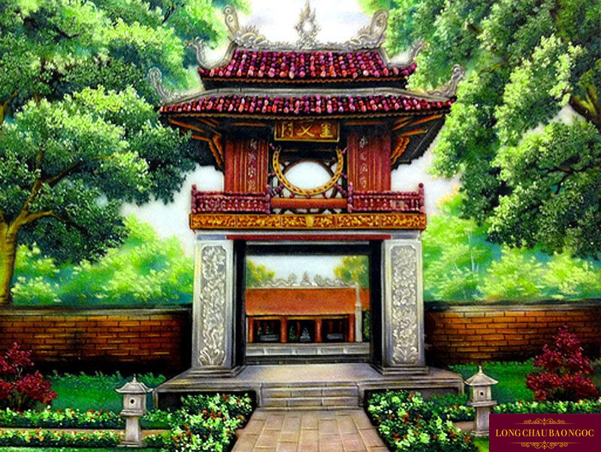
Temple of Literature
Quoc Tu Giam
VietNam’s first university

Slide 4
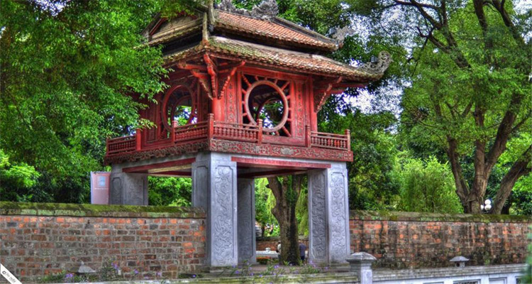
It was constructed in 1070.
It was a school for princes and royal families children.
Then expanded to admit to students from around the coutry.

Slide 5
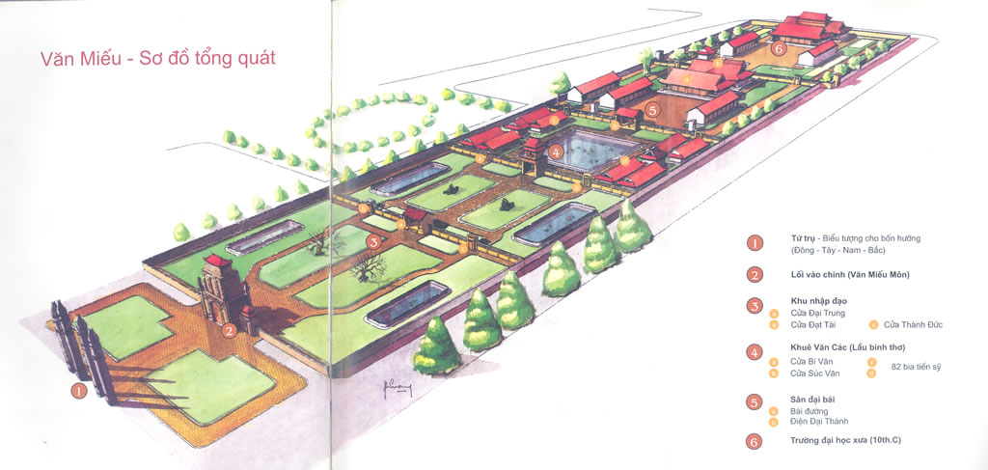
It is located in Ha Noi, the south of Thang Long royal citadel.
It divided into 5 separate areas.

Slide 6
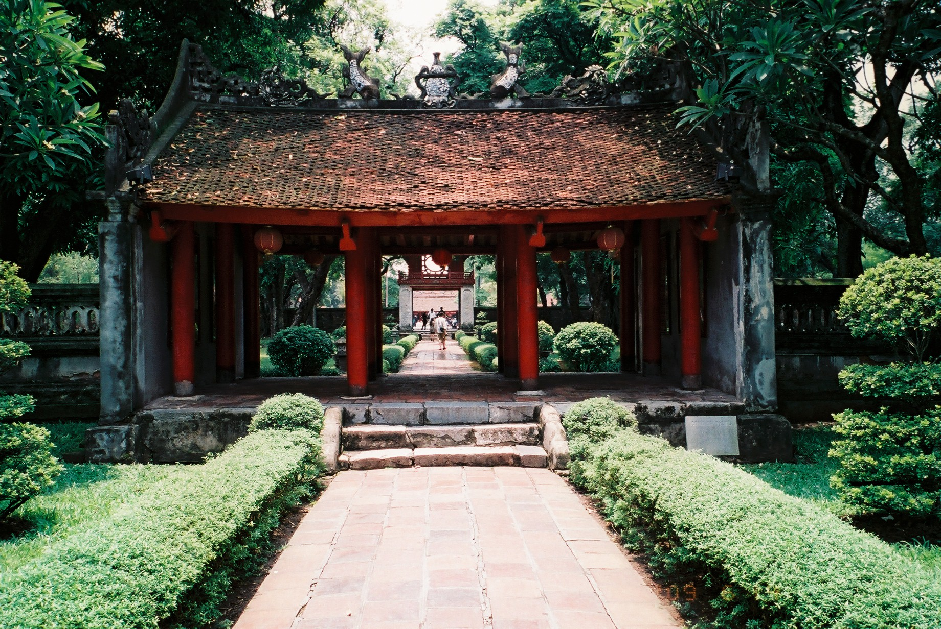
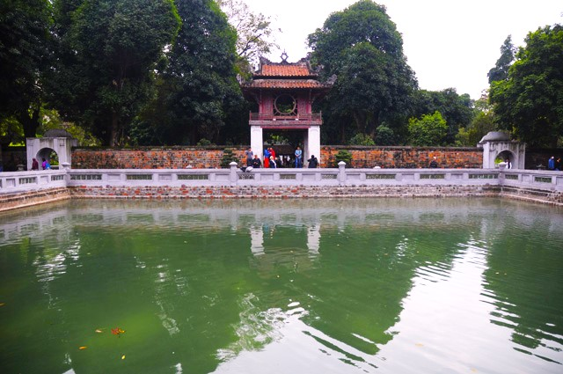
Dai Trung Mon
Khue Van Cac
Thien Quang Well

Slide 7
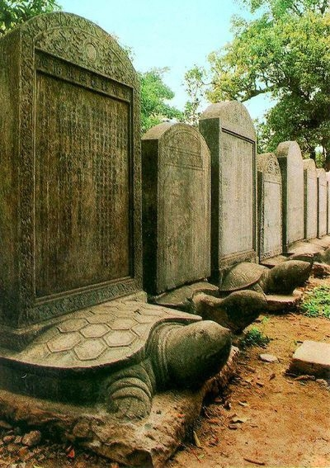
STELAE OF DOCTORS
82 stone steles sympolize the people who have ever achieved the title in Quoc Tu Giam.
It is the most valuable objects symbolize the fondness of Vietnamese people through 82 examinations.

Slide 8
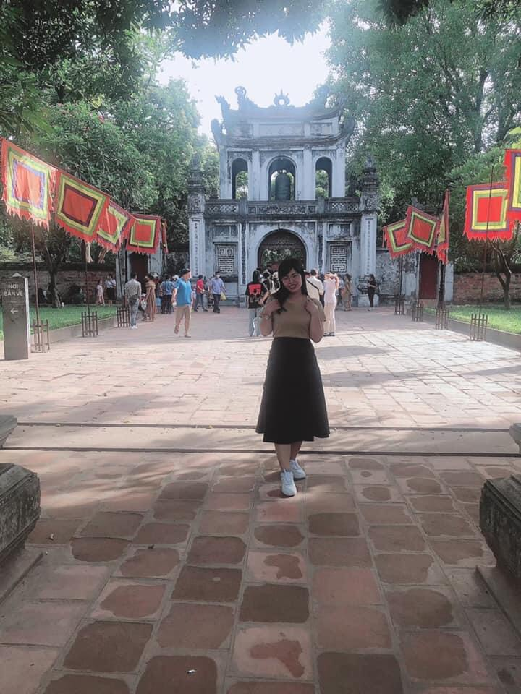
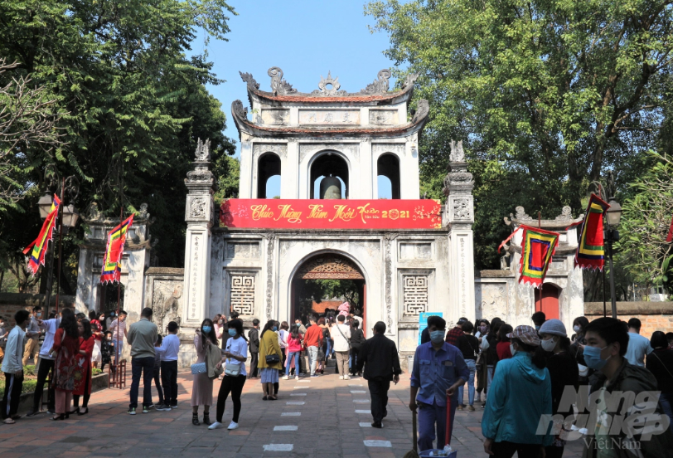
Nowadays, Van Mieu – Quoc Tu Giam is one of the most attractive tourist spots in Northern Vietnam
Nowadays, Van Mieu – Quoc Tu Giam is one of the most attractive tourist spots in Northern Vietnam

Slide 9
THANKS FOR YOUR ATTENTION!

Slide 10
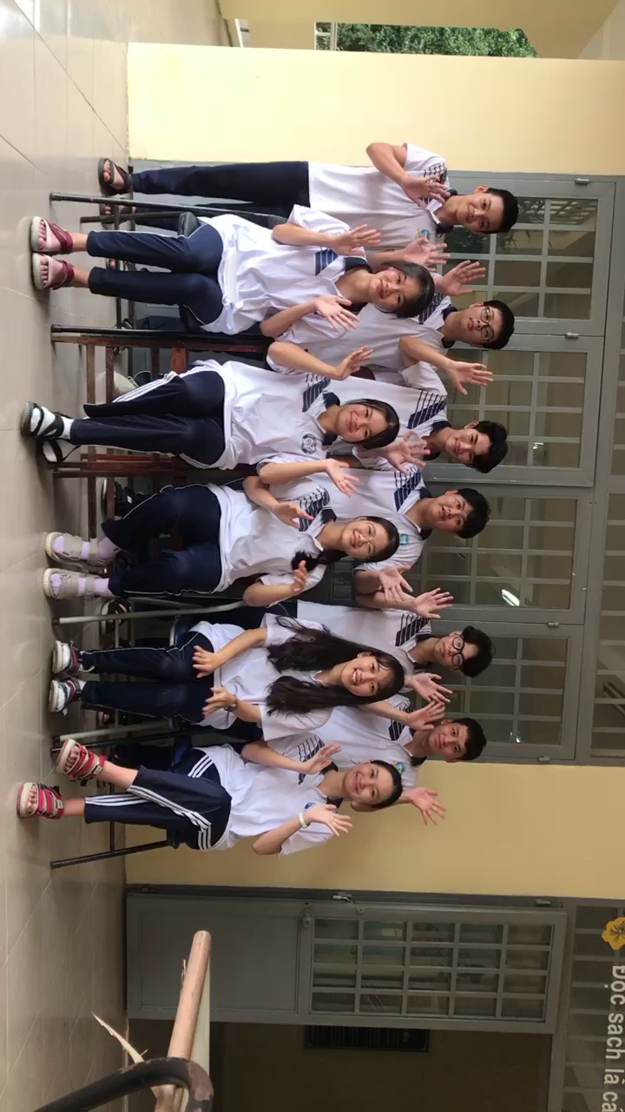

Slide 11
Thư pháp

Slide 12
Presentation by Tuyet Anh

Slide 13
Psychological quiz https://www.collegecovered.com/getting-into-college/quiz-what-type-of-college-is-the-best-fit-for-me/
Presented by Thu Thao + Quynh Tram

Slide 14

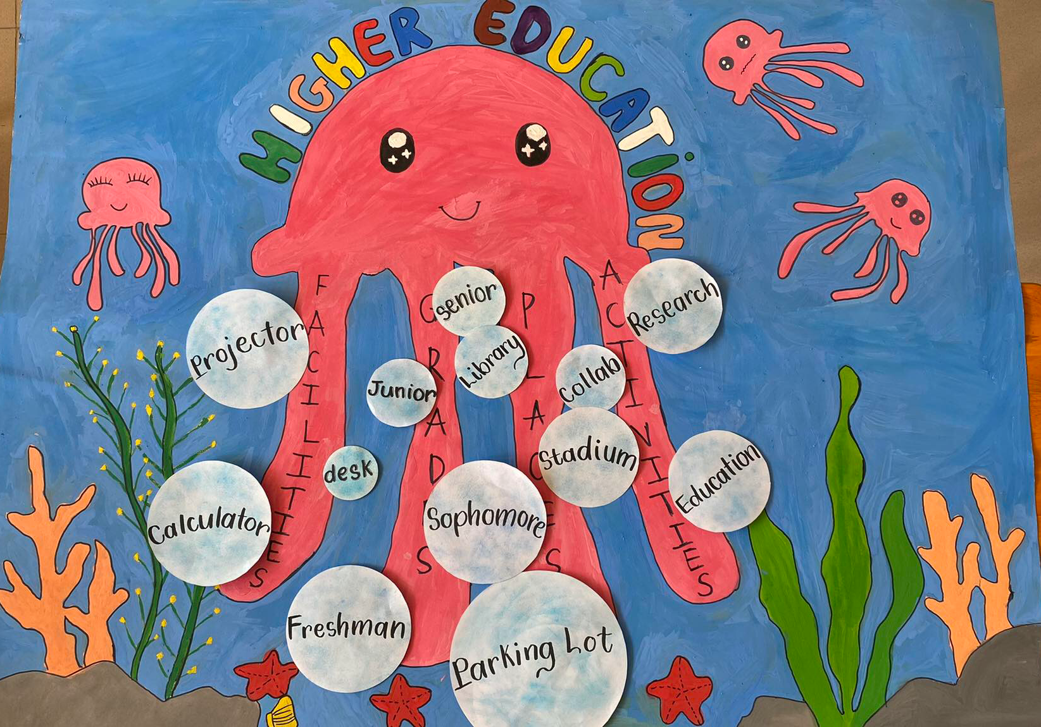
Vocabulary Mind map

Slide 15
Song: Be what you wanna be

Slide 16
Thank you for your attention!

